Slide 1
Object Oriented Software Engineering (OOSE)
22CS017
Project Scheduling
By
Dr. Annu Priya

Slide 2
Index
What is Project Scheduling
Basic Principle of Project Scheduling
Project Scheduling Techniques
Earned Value Analysis
Practice Questions

Slide 3
Introduction to Project Scheduling
Scheduling in project management is the listing of activities, deliverables, and milestones within a project.
A schedule also usually includes a planned start and finish date, duration, and resources assigned to each activity.
Effective project scheduling is a critical component of successful time management.
When people discuss the processes for building a schedule, they are usually referring to the first six processes of time management:
Plan schedule management
Define project activities
Sequence activities
Estimate resources
Estimate durations
Develop the project schedule

Slide 4
Project Scheduling
Project-task scheduling is a significant project planning activity. It comprises deciding which functions would be taken up when.
To schedule the project plan, a software project manager wants to do the following:
Identify all the functions required to complete the project.
Break down large functions into small activities.
Determine the dependency among various activities.
Establish the most likely size for the time duration required to complete the activities.
Allocate resources to activities.
Plan the beginning and ending dates for different activities.
Determine the critical path. A critical way is the group of activities that decide the duration of the project.

Slide 5
The role of project scheduling in software engineering
Project scheduling plays a vital role in software engineering. It helps in managing resources effectively, ensuring that they are allocated optimally to achieve project goals.
By breaking down the project into smaller tasks and assigning time frames to each, project scheduling allows for better control and monitoring of progress.
Furthermore, project scheduling in software engineering enables developers to identify critical paths and milestones within a project.
It helps prioritize tasks and activities, ensuring that the most critical elements are addressed first.
This not only enhances project efficiency but also reduces the risk of delays and cost overruns.

Slide 6
Needs of Project Scheduling
Today’s software systems are large , sophisticated and complex
Many software engineering tasks occur in parallel
Result of work performed during one task may have a profound effect on work conducted in another task.
Task interdependencies are very difficult to understand without a schedule
It is virtually impossible to access progress on a large software project without a detailed schedule.

Slide 7
Project Scheduling Basic Principles
Compartmentalization. The project must be compartmentalized into a number of manageable activities and tasks. To accomplish compartmentalization, both the product and the process are refined.
Interdependency. The interdependency of each compartmentalized activity or task must be determined. Some tasks must occur in sequence, while others can occur in parallel. Some activities cannot commence until the work product produced by another is available. Other activities can occur independently.
Time allocation. Each task to be scheduled must be allocated some number of work units (e.g., person-days of effort). In addition, each task must be assigned a start date and a completion date that are a function of the interdependencies and whether work will be conducted on a full-time or part-time basis.

Slide 8
Project Scheduling Basic Principles (Conti.)
Effort validation. Every project has a defined number of people on the software team. As time allocation occurs, you must ensure that no more than the allocated number of people have been scheduled at any given time.
Defined responsibilities. Every task that is scheduled should be assigned to a specific team member.
Defined outcomes. Every task that is scheduled should have a defined outcome. For software projects, the outcome is normally a work product (e.g., the design of a component) or a part of a work product. Work products are often combined in deliverables.
Defined milestones. Every task or group of tasks should be associated with a project milestone. A milestone is accomplished when one or more work products has been reviewed for quality and has been approved.

Slide 9
Project Scheduling Techniques
1. Mathematical Analysis
i. Critical Path Method (CPM) and Program Evaluation and Review Technique (PERT) are the two most commonly used techniques by project managers. These methods are used to calculate the time span of the project through the scope of the project.
Critical Path Method: The Critical Path Method estimates the maximum and minimum time required to complete a project.
CPM also helps to identify critical tasks that should be incorporated into a project. Delivery time changes do not affect the schedule.
The scope of the project and the list of activities necessary for the completion of the project are needed for using CPM. Next, the time taken by each activity is calculated.
Then, all the dependent variables are identified. This helps in identifying and separating the independent variables. Finally, it adds milestones to the project.

Slide 10
Project Scheduling Techniques (Conti.)
Program Evaluation and Review Technique (PERT)
PERT is a way to schedule the flow of tasks in a project and estimate the total time taken to complete it.
This technique helps represent how each task is dependent on the other.
To schedule a project using PERT, one has to define activities, arrange them in an orderly manner and define milestones.
You can calculate timelines for a project on the basis of the level of confidence:
Optimistic timing
Most-likely timing
Pessimistic timing

Slide 11
Project Scheduling Techniques (Conti.)
2. Duration Compression
Duration compression helps to cut short a schedule if needed. It can adjust the set schedule by making changes without changing the scope in case, the project is running late. Two methodologies that can be applied:
Fast Tracking: Fast-tracking is another way to use CPM.
Fast-tracking finds ways to speed up the pace at which a project is being implemented by either simultaneously executing many tasks or by overlapping many tasks to each other.
CPM helps us identify activities that can be used to speed up the pace of the project. Although it is an appealing technique, it has its own share of risks too.
As many activities will be simultaneously implemented, it is highly to make mistakes and compromise on quality.

Slide 12
Project Scheduling Techniques (Conti.)
Crashing
Crashing deals with involving more resources to finish the project on time. For this to happen, you need spare resources to be available at your disposal.
Need to add new team members to a project and limited divisibility of tasks leads to increase communication.
The crashing technique can also be used by adding time, paid overtime, but it should stay within the decided deadline.
It, unfortunately, leads to raising the cost of the project.

Slide 13
Project Scheduling Techniques (Conti.)
3. Task List
The task list is the simplest project scheduling technique of all the techniques available.
Documented in a spreadsheet or word processor is the list of all possible tasks involved in a project.
This method is simple and the most popular of all methods.
It is very useful while implementing small projects.
But for large projects with numerous aspects to consider task list is not a feasible method.

Slide 14
Project Scheduling Techniques (Conti.)
4. Gantt Chart
For tracking progress and reporting purposes, the Gantt Chart is a visualization technique used in project management.
It is used by project managers most of the time to get an idea about the average time needed to finish a project.
A project schedule Gantt chart is a bar chart that represents key activities in sequence on the left vs time.
Each task is represented by a bar that reflects the start and date of the activity, and therefore its duration.

Slide 15
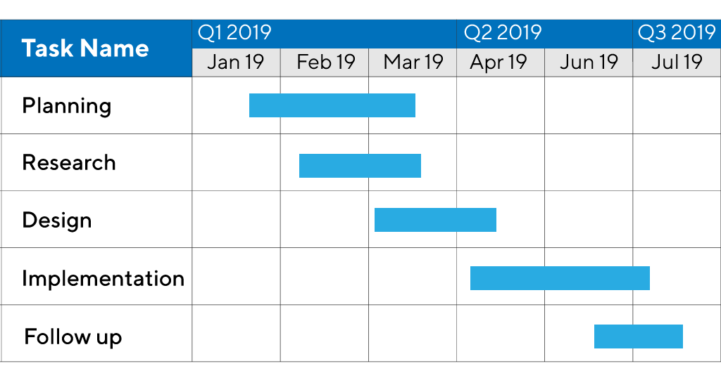
Project Scheduling Techniques (Conti.)
Gantt Chart Example
Figure 1: Gantt Chart

Slide 16
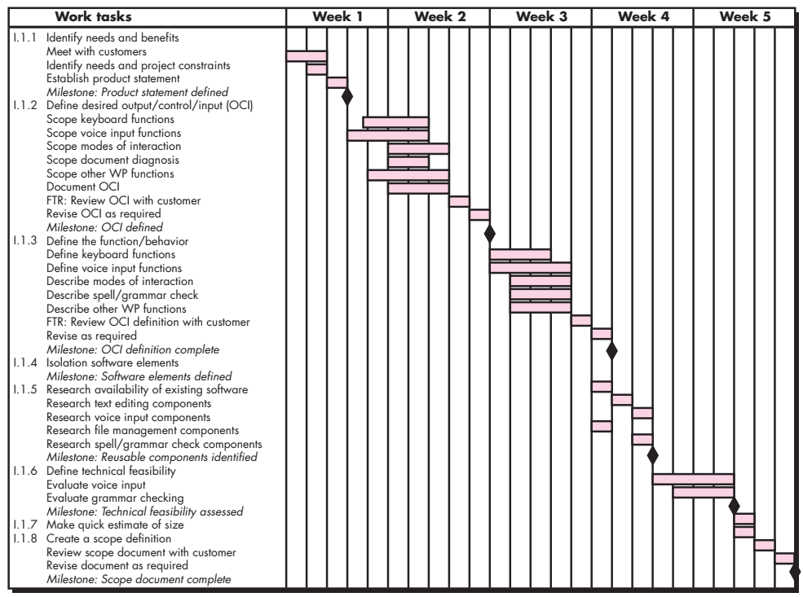
Project Scheduling Techniques (Conti.)
Gantt Chart Example for software project schedule
Figure 2: Gantt Chart Example

Slide 17
Top 10 Project Scheduling Tools
Microsoft Project
Daily Activity Reporting and Tracking (DART)
Monday.com
ProjectManager.com
SmartTask
ProofHub
Asana
Wrike
GanttPRO
Zoho Projects

Slide 18
Earned Value Analysis
What is Earn Value
is a measure of progress
Provides a quantitative indication of progress
Enables us to assess the “percentage of completeness” of a project using quantitative analysis.
What is Earned Value Analysis(EVA)
is a quantitative technique for assessing progress as the software project team moves through
the work tasks, allocated to the Project Schedule.
Total hours to complete the project are estimated and every task is given an Earned Value, based on its estimated (%) of the total.
“Earned Value Analysis (EVA) is a project management technique used to measure project performance by comparing the planned progress with actual progress. It integrates scope, schedule, and cost data to provide a clear picture of project health”
The earned value system provides a common value scale for every [software project] task, regardless of the type of work being performed. The total hours to do the whole project are estimated, and every task is given an earned value based on its estimated percentage of the total.
Stated even more simply, earned value is a measure of progress. It enables you to assess the “percent of completeness” of a project using quantitative analysis rather than rely on a gut feeling.

Slide 19
Earned Value Analysis (Conti.)
Planned Value (PV) – The approved cost baseline for the work package. It was earlier known as Budgeted Cost of Work Scheduled (BCWS).
Earned Value (EV) – The budgeted value of the completed work packages. It used to be known as Budgeted Cost of Work Performance at a specified point (BCWP).
Actual Cost (AC) – The actual cost incurred during the execution of work packages up to a specified point in time. It was previously called Actual Cost of Work Performed (ACWP).

Slide 20
Earned Value Computing – Steps (Conti.)
The budgeted cost of work scheduled (BCWS) is determined for each work task represented in the schedule. During estimation, the work (in person-hours or person-days) of each software engineering task is planned. Hence, BCWS_{i} is the effort planned for work task i. To determine progress at a given point along the project schedule, the value of BCWS is the sum of the BCWS_{i} values for all work tasks that should have been completed by that point in time on the project schedule.
The BCWS values for all work tasks are summed to derive the budget at completion (BAC). Hence,
Next, the value for budgeted cost of work performed (BCWP) is computed. The value for BCWP is the sum of the BCWS values for all work tasks that have actually been completed by a point in time on the project schedule.

Slide 21
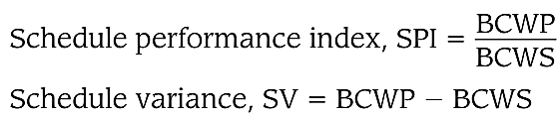


Earned Value Computing – Steps (Conti.)
SPI is an indication of the efficiency with which the project is utilizing scheduled resources. An SPI value close to 1.0 indicates efficient execution of the project schedule.
SV is simply an absolute indication of variance from the planned schedule.
Percent scheduled for completion provides an indication of the percentage of work that should have been completed by time t.
Percent complete provides a quantitative indication of the percent of completeness of the project at a given point in time t.

Slide 22
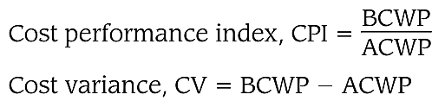
Earned Value Computing – Steps (Conti.)
It is also possible to compute the actual cost of work performed (ACWP).
The value for ACWP is the sum of the effort actually expended on work tasks that have been completed by a point in time on the project schedule.
A CPI value close to 1.0 provides a strong indication that the project is within its defined budget.
CV is an absolute indication of cost savings (against planned costs) or shortfall at a particular stage of a project.

Slide 23
Practice Questions
Q1 - In which sort of project is the use of a Gantt chart most appropriate?
Projects with few activities and resources involved.
Projects where the time periods involved are very short.
Projects with many activities involved.
Projects in which the use of resources must be carefully monitored.
Q2- You are the Project Manager on a construction project. You have worked with your team to define the dependencies and estimated their durations and resource requirements. Now you are creating the project schedule. Which of the following tools and techniques is of no use at this time?
Resource leveling
Schedule Compression
Critical Chain Method
Reserve Analysis
Q3- The customer is looking for the project to be complete 10 days earlier than planned due to marketing constraints. You work with your project team and figure out that this can be achieved if a couple of activities can overlap. This approach is known as?
Crashing
Resource Leveling
Concurrent Engineering
Fast Tracking

Slide 24
Conti.
Which of the following is NOT a project scheduling technique?
A) Critical Path Method (CPM) B) Program Evaluation and Review Technique (PERT) C) Gantt Chart D) Balance Sheet Analysis
The technique that uses a probabilistic approach to project scheduling is:
A)Critical Path Method (CPM) B) Program Evaluation and Review Technique (PERT) C) Gantt Chart D) Resource Leveling
The Critical Path in a project schedule is the path that:
A) Has the longest duration and determines the shortest time to complete the project B) Has the most expensive activities C) Includes only the important tasks D) Can be delayed without affecting the project timeline
In a Gantt chart, what does a bar represent?
A) The cost of a task B) The start and finish of a task C) The number of workers assigned D) The budget of a project

